Slide 1
Random Access Machines
A Model to Reason about Algorithms
Foundations / Lecture 2
Franck Chauvel
Axbit & NTNU
Ask anything at menti.com with code 6748 8844
franck.chauvel@ntnu.com

Slide 2
Remember
Algorithm:
sequence of instructions that solves a computational problem.
1
1
1
4
1
7
9
+
0
9
6
7
5
1
4
6

Slide 3
Algorithms & Computations
Problem
(add)
number (input)
arabic numbers
number (output)
arabic numbers
number (input)
arabic numbers
Algorithm
(primary school)
number (output)
arabic numbers
4179
967
computation
5146

Slide 4
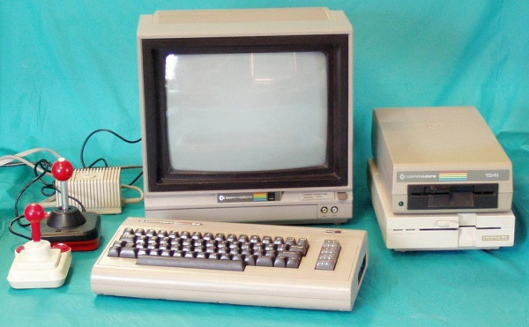
Who is the Computer?
People
Machines

Slide 5
Agenda
Random Access Machine
Machine Code
Assembly Code
Pseudo Code

Slide 6
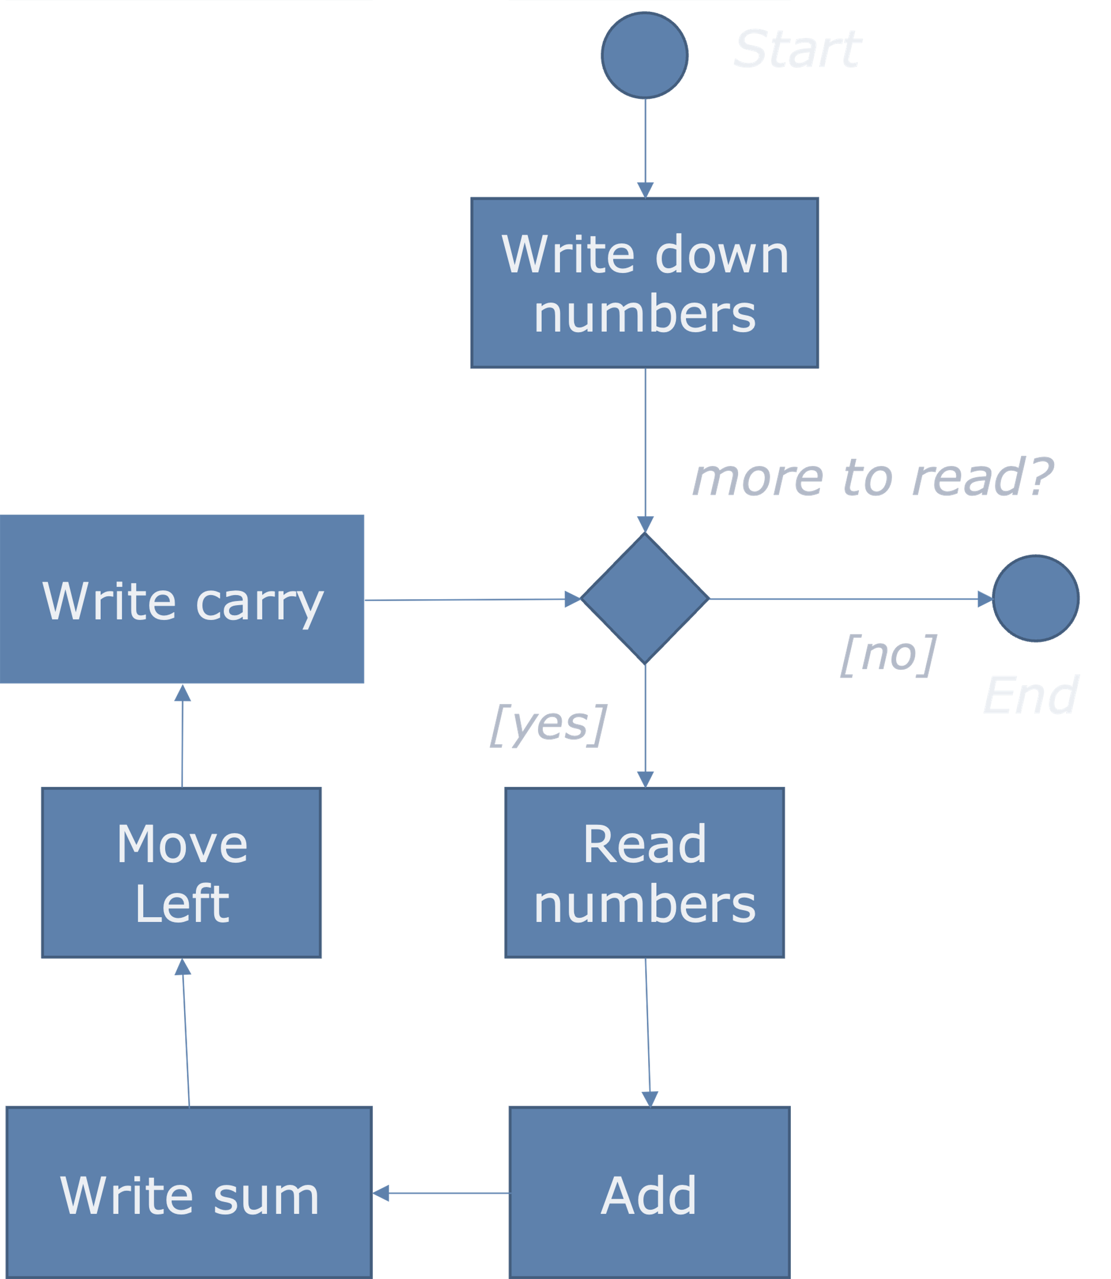
Automation
4179, 967
inputs
algorithm
Executor
There are many kinds of machines we can build…
output
5146

Slide 7
Random Access Machine
Sequential Machine that Processes Symbols

Slide 8
The Pieces
a word (e.g., “123”)
Random Access
Machine
Memory
00
02
input device
02
03
CPU
ACC
04
IP
05
06
output device
arithmetic and logic
operations
⇣
∞

Slide 9
The Instructions
Code | Mnemonic | Parameter | Semantic
1 | LOAD | value | ACC := value IP := IP + 2
2 | ADD | address | ACC := ACC + memory[address] IP := IP + 2
3 | SUBTRACT | address | ACC := ACC - memory[address] IP := IP + 2
4 | STORE | address | memory[address] := ACC IP := IP + 2
5 | JUMP | address | if ACC = 0 then IP := address else IP := IP + 1
6 | READ | address | memory[address] := input IP := IP + 2
7 | PRINT | address | output := memory[address] IP := IP + 2
? | HALT

Slide 10
Instructions Are Also “Symbols” We can store them in memory
00
x
code
x+1
arg
Each instruction takes 2 memory cells
Inputs = Outputs = Code = Address = Symbols
address

Slide 11
Machine Code
Random Access
Machine
Memory
00
56
100
CPU
1 instruction
ACC
ACC
50
150
IP
124
124
Code: ADD
126
3
125
56
Operand (address)
ACC := ACC + memory[address]
IP := IP + 2

Slide 12
Example: Adding 2 Numbers
read 15
load 0
add 15
read 15
add 15
store 15
print 15
Random Access
Machine
Memory
00
01
00
6
15
02
1
0
04
2
15
CPU
ACC
110
???
0
99
06
6
15
2
4
10
IP
8
0
6
12
08
2
15
10
4
15
12
7
15
110
99
14
11

Slide 13
Programming Languages
Assembly code and pseudocode

Slide 14
Memory Layout
Random Access
Machine
Memory
00
CODE segment
algorithm / instructions
CPU
ACC
ACC
50
IP
124
DATA segment
Inputs / Intermediate results

Slide 15
Assembly Code
segment: data
value 1 0 ; value := 0
segment: code
read value ; value := user-input
load 0 ; ACC := 0
add value ; ACC := ACC + value
read value ; value := user-input
add value ; ACC := ACC + value
store value ; value := ACC
print value ;
halt
6 15 1 0
2 15 6 15
2 15 4 15
7 15
assemble
machine code

Slide 16
Pseudo-code?
program add_two_numbers()
begin
var value: Integer = 0;
value := read();
value := value + read();
print(value);
end
segment: data
value 1 0
segment: code
read value
load 0
add value
read value
add value
store value
print value
halt
compile

Slide 17
Sequences
ASM for “Step 1”
<step 1> ;
<step 2> ;
ASM for “Step 2”

Slide 18
Assignements
Assembly for “expression”
x := <expression>;
STORE address(x)

Slide 19
Arithmetic Expressions
x := 12;
x := 12 + v;
x := a + (b – 5);
LOAD 12
LOAD 12
ADD address(v)

Slide 20
Conditionals
Assembly for “not expression”
JUMP else
if (expression) then
code X
else
code Y
end
ASM for “Code X”
LOAD 0
JUMP end
else:
ASM for “Code Y”
end:
…

Slide 21
Loops
loop:
Assembly for “not expression”
while (expression) then
// some code X
end
JUMP done
ASM for “Code X”
LOAD 0
JUMP loop
done:
…

Slide 22
Big Picture
Programs
Algorithms
Problems
correctness
Algorithm 1
efficiency
$$f\left(x,y\right)=x+y$$
Algorithm 2

Slide 23
Recap
Computation
Symbol transformation
Computer Science
Anything the manipulate symbols
RAM (this course)
“Sequential” machine
Useful to reason about algorithms
Correctness
Do we solve the problem?
Efficiency
Is there a better way to use the resources?

Slide 24
Questions, Comments, or Ideas?
Franck Chauvel
Axbit & NTNU
franck.chauvel@ntnu.no

Slide 25
Programs or Algorithms?
LIMIT = 100
half = LIMIT / 2
total = half * (half + 1)
print(f"Total: {total}")
#include <stdio.h>
#define LIMIT 100
int main(int argc, char** argv) {
int sum = 0;
for (int any_integer=0;
any_integer <= LIMIT ;
any_integer++) {
if (any_integer % 2 == 0) {
sum += any_integer;
}
}
printf("Total: %d\n", sum);
}
(define (sum-of-even n)
(* (/ n 2)
(+ (/ n 2) 1)))
(print (sum-of-even 100))

Slide 26
Programs to Algorithms
LIMIT = 100
half = LIMIT / 2
total = half * (half + 1)
print(f"Total: {total}")
start
tmp ← n/2
sum ← tmp*(tmp+1)
(define (sum-of-even n)
(* (/ n 2)
(+ (/ n 2) 1)))
(print (sum-of-even 100))
end

Slide 27
Programs to Algorithms
start
#include <stdio.h>
#define LIMIT 100
int main(int argc, char** argv) {
int sum = 0;
for (int any_integer=0;
any_integer <= LIMIT ;
any_integer++) {
if (any_integer % 2 == 0) {
sum += any_integer;
}
}
printf("Total: %d\n", sum);
}
sum ← 0
each ← 0
each ≤ limit
[no]
stop
[yes]
[no]
each ← each + 1
each % 2 = 0
[yes]
sum ← sum + each

Slide 28
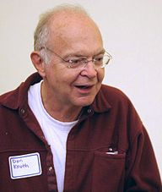
Correctness vs. Efficiency
“Premature optimization is the root of all evil (or at least most of it) in programming.”
— Donald E. Knuth. 1974. Computer Programming as an Art. Communications of the ACM 17, 12 (Dec 1974). p. 671

Slide 29
But who executes these instructions?

Slide 30
The RAM Model
One Minimal and Abstract Executor

Slide 31
Further Readings
Stephen Cook & Robert Reckhow, Time bounded random access machines, Journal of Computer and System Sciences, 7(4), 354-375 (1973).
Hill, Robin K. "What an algorithm is." Philosophy & Technology 29, no. 1 (2016): 35-59.

Slide 32
Next: Lab Session
Let us write some small programs for the RAM machine.
segment: data
value 1 0 ; value := 0
segment: code
read value ; value := user-input
load 0 ; ACC := 0
add value ; ACC := ACC + value
read value ; value := user-input
add value ; ACC := ACC + value
store value ; value := ACC
print value ;
halt

