Slide 1
Quantum Computing
From a distance
Beyond RAM / Lecture 2
Franck Chauvel
Ask anything on menti.com with code 2855-5096
axbit & NTNU
Based on a Microsoft Research Talk
franck.chauvel@ntnu.no

Slide 2
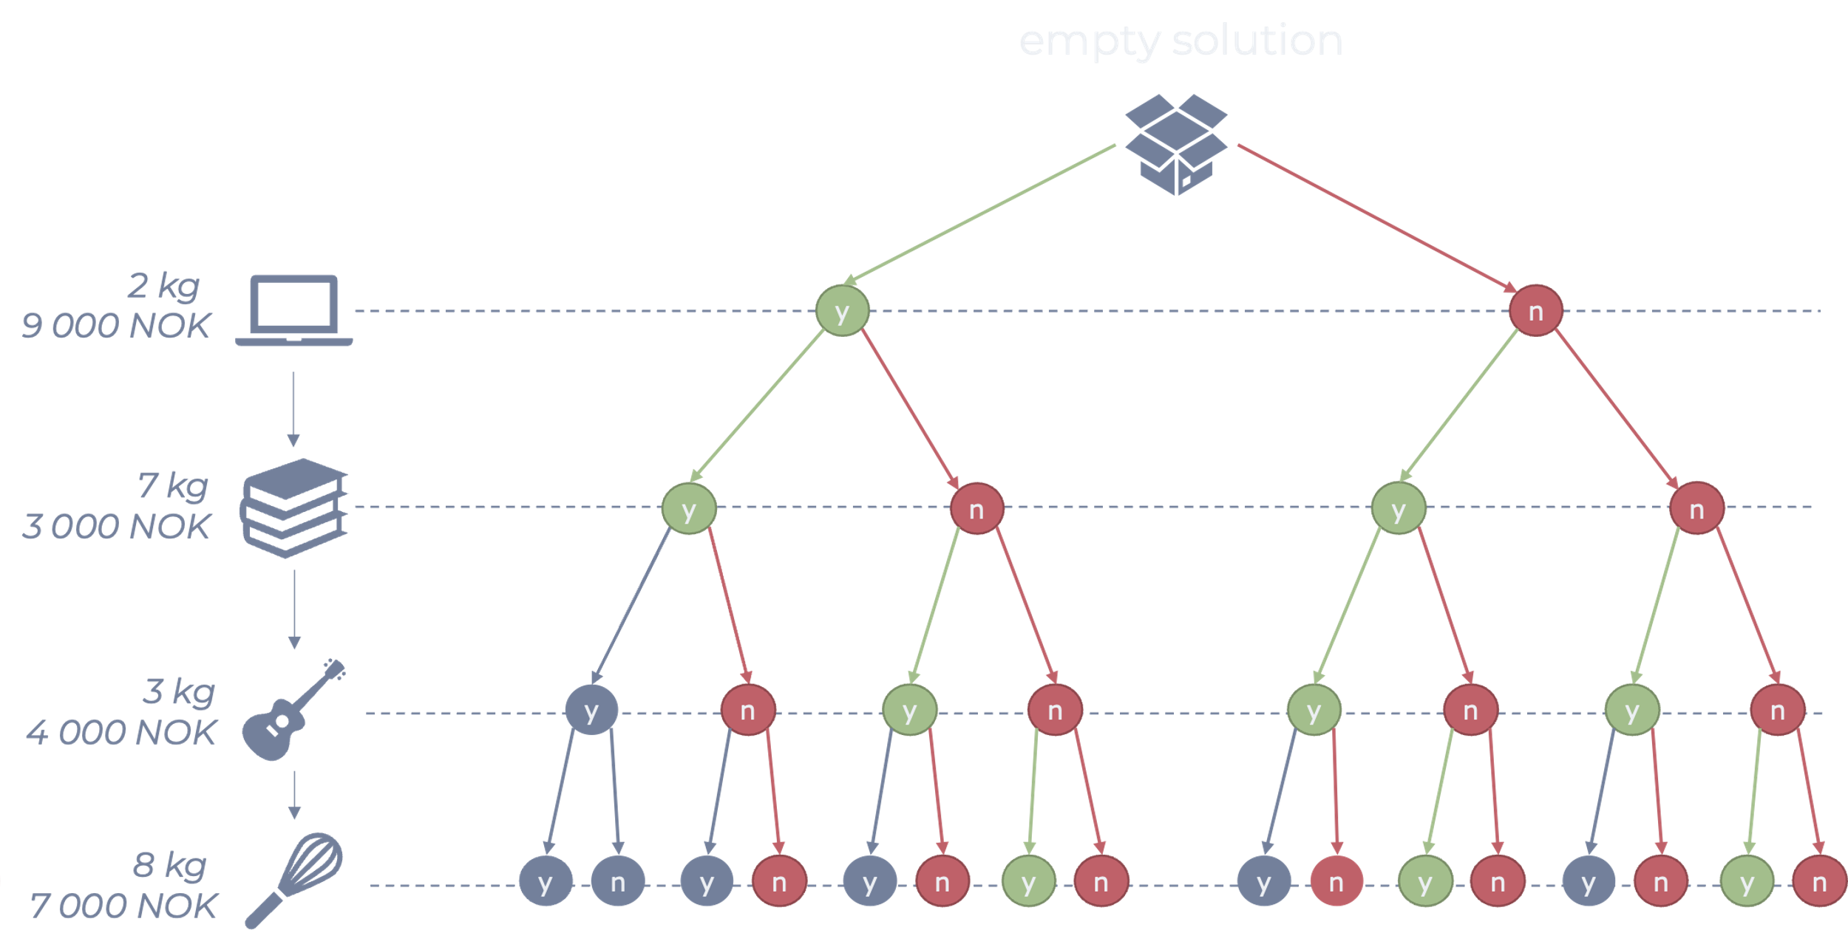
Non-Deterministic Turing Machine
A non-deterministic machine
always picks
the right branch

Slide 3
Non-deterministic Turing Machines
Non-deterministic Turing Machines
would give us …
Exponential Speed-up!

Slide 4
Quantum Supremacy?
On Oct. 23, 2019, Google performed
a series of operations in 200 seconds
that would take a supercomputer
about 10,000 years to complete.

Slide 5
Disclaimer

Slide 6
Agenda
What is Quantum Computing?
How it works?
qBits, superposition
Reversibility
Deutsch Oracle Problem
Example
BQP
Tool

Slide 7
Classical Computing
cBit {0, 1}
Unary Operations / Gates
SET-0
SET-1
ID
NOT
Binary Operations / Gates
OR
AND
XOR
NAND

Slide 8
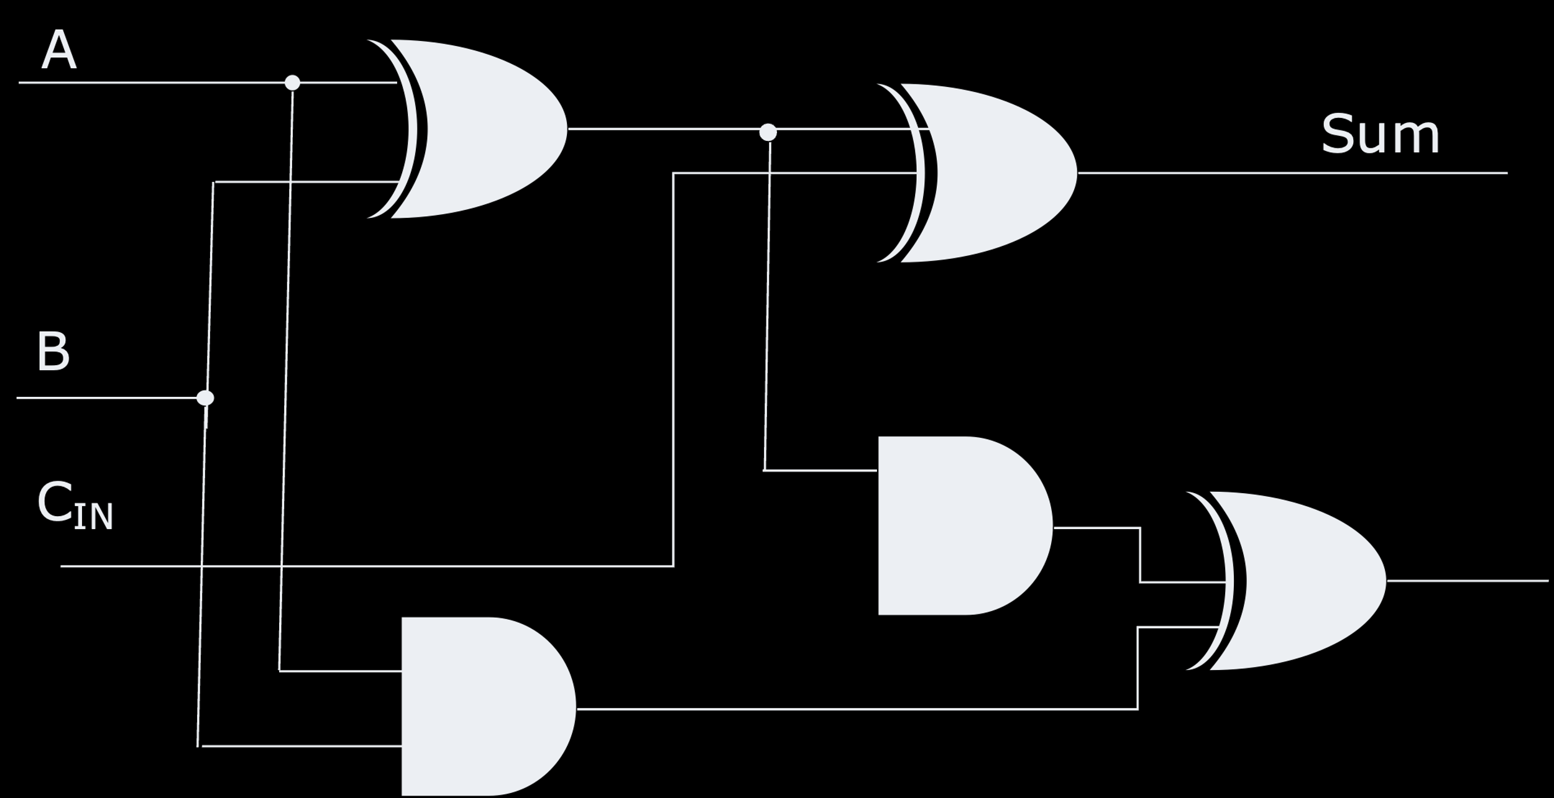
Boolean Circuits

Slide 9
Qubits & Quantum Gates
$$|1⟩ = \left[\begin{matrix}0 \\ 1\end{matrix}\right]$$
I
$$Id= \left[\begin{matrix}1 & 0 \\ 0 & 1\end{matrix}\right]$$
1
X
$$NOT= \left[\begin{matrix}0 & 1 \\ 1 & 0\end{matrix}\right]$$
$$|0⟩ = \left[\begin{matrix}1 \\ 0\end{matrix}\right]$$
0
AND
$$AND= \left[\begin{matrix}1 & 1 & 1 & 0 \\ 0 & 0 & 0 & 1\end{matrix}\right]$$
OR
$$OR= \left[\begin{matrix}0 & 0 & 0 & 1 \\ 1 & 1 & 1 & 0\end{matrix}\right]$$

Slide 10
Quantum Superpostion

Slide 11
Quantum Superposition
$$|1⟩ = \left[\begin{matrix}0 \\ 1\end{matrix}\right]$$
$$\left[0\right\rangle +[1⟩$$
1
$$|c⟩= \left[\begin{matrix}a \\ b\end{matrix}\right]=a\left|0\right\rangle +b|1⟩$$
$$|0⟩ = \left[\begin{matrix}1 \\ 0\end{matrix}\right]$$
0

Slide 12
Measurement
When we measure a qubit
It chooses either $|0⟩$ or $|1⟩$
$|c⟩= \left[\begin{matrix}a \\ b\end{matrix}\right]=a\left|0\right\rangle +b|1⟩$
$\operatorname{Pr}{(|c⟩}=|0⟩)=a^{2}$
$\operatorname{Pr}{(|c⟩}=|1⟩)=b^{2}$
$$|c⟩$$
$$\{0, 1\}$$

Slide 13
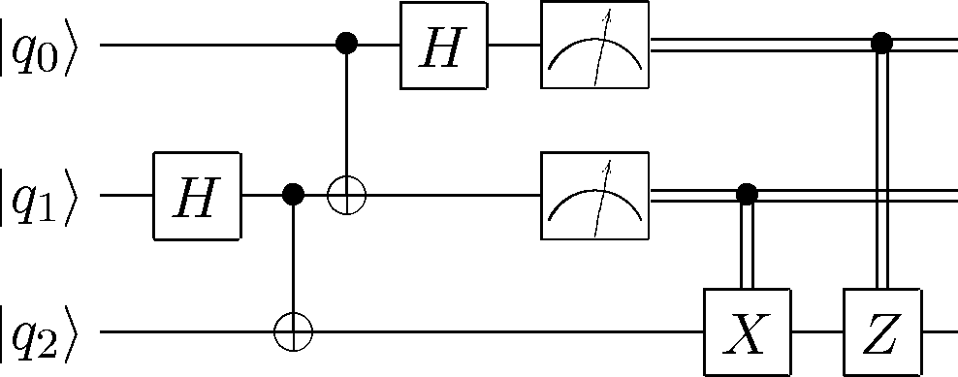
Quantum Circuits

Slide 14
Quantum “Reversible” Gates
Reversible
Gate
Gate
$$\left|0\right\rangle$$
$$f(|x⟩)$$
Input
Output
$$|x⟩$$
$$|x⟩$$

Slide 15
Hadamard Gate
$$|1⟩ = \left[\begin{matrix}0 \\ 1\end{matrix}\right]$$
Equal Superposition
1
$$H$$
$$|x⟩$$
$$H$$
$$H(|x⟩)$$
$$|0⟩ = \left[\begin{matrix}1 \\ 0\end{matrix}\right]$$
$$H= \left[\begin{matrix}\frac{1}{√2} & \frac{1}{√2} \\ \frac{1}{√2} & \frac{−1}{√2}\end{matrix}\right]$$
0

Slide 16
Controlled NOT
$$CNOT(|ct⟩)= \left\{\begin{matrix}|ct⟩ & if \left|c\right\rangle =|0⟩ \\ |c¬t⟩ & if \left|c\right\rangle =|1⟩\end{matrix}\right.$$
control
CNOT
$$\left|c\right\rangle$$
$$|c⟩$$
target
$$|t⟩$$
$$CNOT(|t⟩)$$
$$CNOT= \left[\begin{matrix}1 & 0 & 0 & 0 \\ 0 & 1 & 0 & 0 \\ 0 & 0 & 0 & 1 \\ 0 & 0 & 1 & 0\end{matrix}\right]$$

Slide 17
Deutsch Oracle Problem
input
identity?
f(b)?
not?
How many attempts do we need
to identify whether $f$ is a
constant function?
set-0?
set-1?
output

Slide 18
Constant Unary Functions Quantum Gates
Constant-0
Constant-1
$$\left|0\right\rangle$$
$$f(|x⟩)$$
$$\left|0\right\rangle$$
X
$$f(¬ |x⟩)$$
$$|x⟩$$
$$|x⟩$$
$$|x⟩$$
$$|x⟩$$

Slide 19
Variable Unary Functions Quantum Gates
Identity
Negation
$$\left|0\right\rangle$$
$$f(|x⟩)$$
$$\left|0\right\rangle$$
X
$$f(|x⟩)$$
$$|x⟩$$
$$|x⟩$$
$$|x⟩$$
$$|x⟩$$

Slide 20
The Deutsch Algorithm
$$f$$
$$\left|0\right\rangle$$
X
H
H
$$|0⟩$$
X
H
H
if $f(x)$ is constant we get $\left|11\right\rangle$
if $f(x)$ is variable we get $|01⟩$

Slide 21
Shor’s Algorithm
Integer prime factorization
Classical computing $O\left(e^{d^{1/3}}\right)$
Shor’s algorithm: $O\left(d^{3}\right)$
323
17
19

Slide 22
Grover’s Algorithm Quantum Linear Search
Runtime: $O(\sqrt{n})$
Quantum Linear Search $∈Ω(\sqrt{n})$
Only a polynomial speed-up!

Slide 23
Skepticism
We just need many qubits ...
It could be that error
increases exponentially
with the number of qubits

Slide 24
P, NP & BQP
NP
BQP
Bound-error quantum polynomial time
We know that
$P⊆BQP$
$NP ⊈BQP$ (grover’s algorithm)
BQP
P
NC

Slide 25
Recap
Quantum Computing
Quantum Physics
Not as good as initially though
Still pretty good speed up!
BQP

Slide 26
Questions, Comments, or Ideas?
Franck Chauvel
Axbit & NTNU
franck.chauvel@ntnu.no

