Slide 1
Minimum Spanning Trees
Efficiently Covering Graphs
Graphs / Lecture 3
Franck Chauvel
axbit & NTNU
Ask questions on menti.com
with code 6447 9648
franck.chauvel@ntnu.no

Slide 2
Putting down wires
Trondheim
12
Max-flow networks
Ålesund
4
5
12
Lillehammer
12
Bergen
Hamar
10
20
Minimum
Spanning Trees
Oslo
8
18
14
Kristiansand

Slide 3
Agenda
Minimum Spanning Trees
  Prim’s Algorithm
  Kruskal’s Algorithm
Recap on Graphs

Slide 4
Minimum Spanning Trees

Slide 5
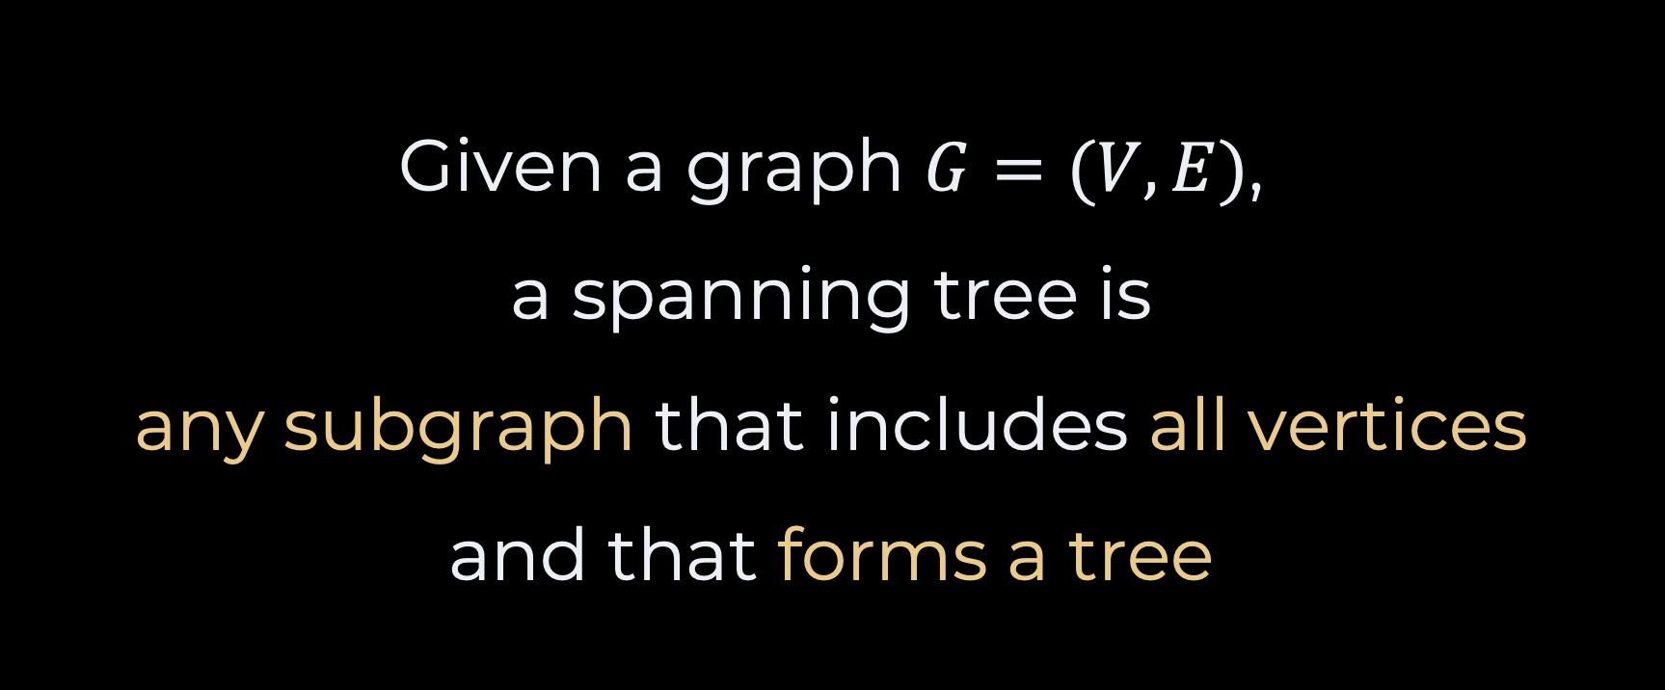
Spanning Trees
Given a graph $G=(V,E)$,
a spanning tree is
any subgraph that includes all vertices
and that forms a tree

Slide 6
Examples
Spanning Trees
A
a graph
B
C
A
A
A
B
C
C
B
C
B

Slide 7
More Examples
-4
1
C
B
E
3
2
-5
1
4
D
A
A

Slide 8
Finding Spanning Trees?
Depth-first Search
Breadth-first Search
C
B
E
C
B
E
D
A
A
D
A
A

Slide 9
Minimum Spanning Trees
For weighted graphs
Weighted Graphs
Spanning Tree with
  Minimum Total Weight
-4
1
C
B
E
3
2
-5
1
4
D
A
A

Slide 10
Prim’s Algorithm
MST
under construction
A
D
C
-4
1
C
C
B
E
B
E
3
3
1
5
3
2
-5
1
8
G
E
4
D
D
A
B
A
F
unvisited vertices

Slide 11
The Code
Prim’s Algorithm
public Tree<T> prim() {
var tree = new Tree<T>();
var edges = allEdges();
while (tree.size() < size()) {
var minimumEdge = findMinimumEdge(tree, edges);
if (!tree.contains(minimumEdge.start) || !tree.contains(minimumEdge.end)) {
tree.add(minimumEdge);
}
edges.remove(minimumEdge);
}
return tree;
}

Slide 12
Kruskal’s Algorithm
3
A
D
-4
1
4
5
C
B
E
2
3
C
B
B
3
2
1
-5
8
7
1
4
B
B
D
A
9
Idea: Merging spanning trees

Slide 13
The Code
Kruskal’s Algorithm
public Tree<T> kruskal() {
var trees = new ArrayList<Tree<T>>();
for (var eachVertex: vertices) trees.add(new Tree<T>(eachVertex));
var edges = allEdges();
while (!anySpanningTree(trees)) {
var minimumEdge = findMinimumEdge(edges);
var startTree = findTree(trees, minimumEdge.start);
var endTree = findTree(trees, minimumEdge.end);
if (startTree != endTree) {
merge(trees, startTree, endTree);
}
edges.remove(minimumEdge);
}
return anySpanningTree(trees);
}
often implemented with
an union-find data structure

Slide 14
Maximum Flows

Slide 15
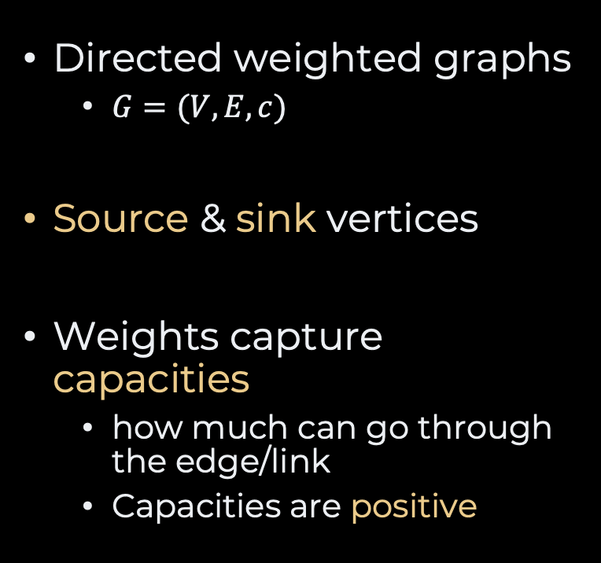
Flow Networks
Trondheim
12
capacities
Directed weighted graphs
  $G=(V,E, c)$
Source & sink vertices
Weights capture capacities
  how much can go through the edge/link
  Capacities are positive
Ålesund
4
5
12
Lillehammer
12
Hamar
Bergen
Hamar
Bergen
10
source
20
sink
Oslo
8
18
14
Kristiansand

Slide 16
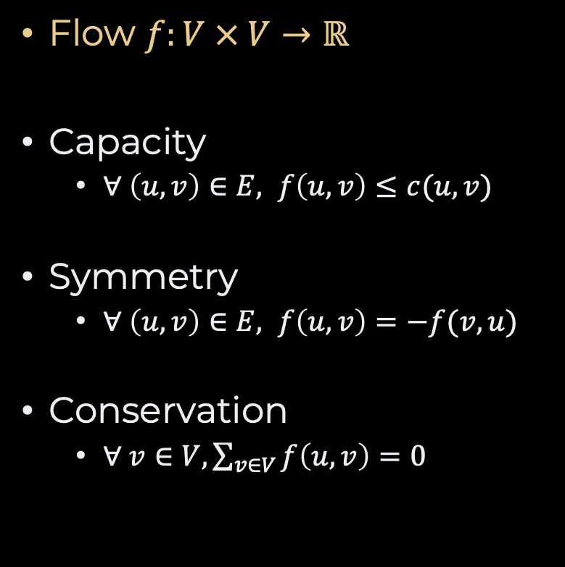
Flows
Trondheim
2 /
12
Flow $f:V × V→ℝ$
Capacity
  $∀ \left(u,v\right)∈E, f\left(u,v\right)≤c(u,v)$
Symmetry
  $∀ \left(u,v\right)∈E, f\left(u,v\right)=−f(v, u)$
Conservation
  $∀ v∈V, \sum_{v∈V}{f\left(u, v\right)=0}$
Ålesund
2 /
4
4 /
5
2 /
12
8 /
12
Lillehammer
Hamar
Bergen
Hamar
Bergen
source
1 /
20
4 /
10
sink
Oslo
8 /
8
3 /
18
8 /
14
Kristiansand

Slide 17

Residual Networks
Trondheim
10 /
12
How much extra can be pushed between vertices?
$r\left(u,v\right)=c\left(u,v\right)−f(u,v)$
Ålesund
2 /
4
1 /
5
10 /
12
Lillehammer
4 /
12
Hamar
Bergen
Hamar
Bergen
source
19 /
20
6 /
10
sink
Oslo
0 /
8
15 /
18
6 /
14
Kristiansand

Slide 18
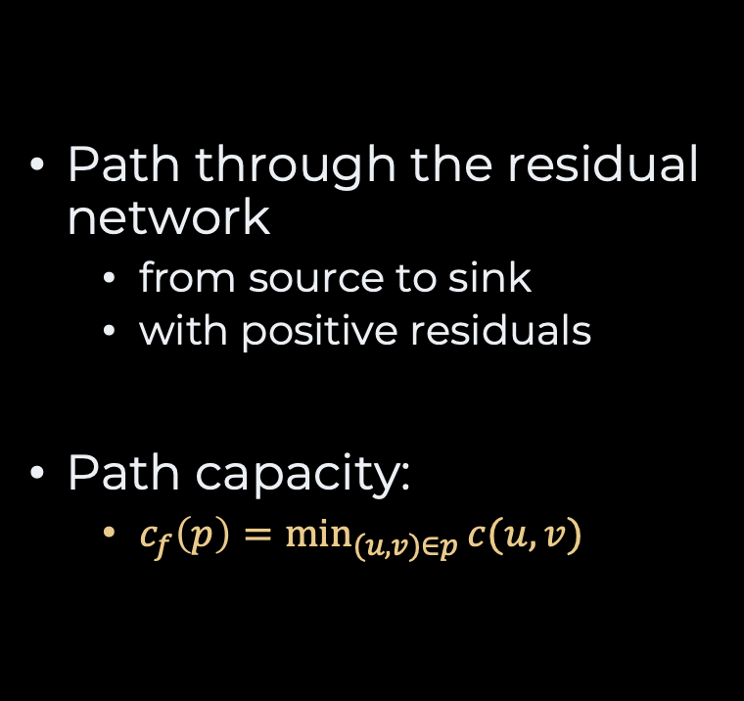
Augmenting Paths
Trondheim
10 /
12
Path through the residual network
  from source to sink
  with positive residuals
Path capacity:
  $c_{f}\left(p\right)=\min_{(u,v)∈p}{c(u,v)}$
Ålesund
2 /
4
1 /
5
10 /
12
Lillehammer
4 /
12
Hamar
Bergen
Hamar
Bergen
source
6 /
10
sink
source
19 /
20
Oslo
0 /
8
15 /
18
6 /
14
Kristiansand

Slide 19
Slow Motion
Ford-Fulkerson Algorithm
Trondheim
12 /
12
Ålesund
4 /
4
minimum
12 /
12
5 /
7 /
0 /
5
12 /
12
Lillehammer
7 /
Hamar
Bergen
Hamar
Bergen
source
20 /
20
10 /
10
sink
Oslo
10 /
18
minimum
8 /
8
18 /
0/
6 /
14 /
14
Kristiansand

Slide 20
Slow Motion
Ford-Fulkerson Algorithm
Ålesund
4
5 /
5
5 /
12
Lillehammer
5 /
12
Hamar
Bergen
Hamar
Bergen
source
sink
Oslo
8/
8
8 /
18
8 /
14
Kristiansand

Slide 21
The Code
Ford-Fulkerson
public Graph<T> newZeroFlow() {
var graph = new Graph();
for (var eachEdge: allEdges()) {
graph.connect(eachEdge.start,
eachEdge.end,
eachEdge.capacity);
}
return graph;
}
public void augmentWith(Path<T> path) {
int minimumFlow = path.minimumFlow();
for (var anyEdge: path.edges.values()) {
var edge = findEdge(anyEdge.start,
anyEdge.end);
edge.reserve(minimumFlow);
}
}
public Graph<T> maximumFlowBetween(T source, T sink) {
var flow = newZeroFlow();
var path = flow.searchAugmentingPath(source, sink);
while (path != null) {
flow.augmentWith(path);
path = flow.searchAugmentingPath(source, sink);
}
return flow;
}

Slide 22
Searching For Augmenting Paths
public Path<T> searchAugmentingPath(T source, T sink) {
var path = new Path<T>();
var visited = new HashSet<T>();
var nextVertices = new LinkedList<T>();
nextVertices.add(source);
while (!nextVertices.isEmpty()) {
var current = nextVertices.remove(0);
visited.add(current);
for(var eachEdge: edgesFrom(current)) {
if (eachEdge.hasResidual() && !visited.contains(eachEdge.end)) {
path.add(eachEdge);
nextVertices.add(eachEdge.end);
if (eachEdge.end == sink) return path;
}
}
}
return null;
}
breadth-first search
dijkstra’s
etc.

Slide 23
Recap
Minimum spanning trees
  Prim: MST + Vertex
  Kruskal: MST + MST
Many more graphs problems
  Connected components
  Longest path
  Transitive closure
  Graph Coloring
  Maximum Flow
  Graph Isomorphism
  Topological Sorting
  Vertex Cover
  Traveling Salesperson Problem
  Vehicule Routing Problem
  etc.

Slide 24
Questions, Comments, or Ideas?
Franck Chauvel
Axbit & NTNU
franck.chauvel@ntnu.no

