Slide 1
String Matching
Introducing Finite Automata
Computational Complexity / Lecture 1
Franck Chauvel
axbit & NTNU
franck.chauvel@ntnu.no

Slide 2
String Matching
Given a text T and a pattern P, check whether T contains P at any position.
Example: Does “splish-splash-splosh” contains “splash”?

Slide 3
Agenda
Brute Force
Finite Automata
KMP: Knuth-Morris-Pratt

Slide 4


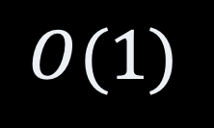

Brute force
0
7
8
11
0
0
1
3
6
1
2
3
6
1
2
2
3
4
5
6
7
8
11
13
14
15
16
17
18
19
4
5
4
5
9
10
12
9
10
12
-
s
p
l
a
s
h
s
-
s
s
p
l
l
l
i
s
h
-
s
p
l
a
s
h
-
s
p
l
o
s
h
s
h
p
s
h
p
i
text
i
s
s
p
l
a
s
h
s
p
l
s
a
p
s
l
h
s
l
a
s
h
s
s
s
p
p
l
a
s
h
s
s
s
p
l
a
p
a
s
h
s
p
l
a
s
h
s
s
s
p
p
l
l
a
a
s
s
h
h
pattern
s
p
l
a
s
h
$$O(\left|T\right|⋅|P|)$$
$$O(1)$$

Slide 5
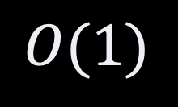

The Code
Brute Force
int contains(char[] text, char[] pattern) {
for (int textSpot = 0; textSpot < text.length ; textSpot++) {
int offset = 0;
while (offset < pattern.length
&& text[textSpot + offset] == pattern[offset]) {
offset++;
}
if (offset == pattern.length) {
return textSpot;
}
}
return -1;
}
$$O(\left|T\right|⋅|P|)$$
$$O(1)$$

Slide 6
How could we go faster?
0
1
2
3
4
5
6
7
8
text
a
b
c
a
b
a
b
c
d
a
b
c
d
pattern
a
b
c
d
How could we skip these steps?
a
b
c
d
a
b
c
d
a
b
c
d
a
b
c
d
a
b
c
d

Slide 7
Repeating Patterns
Repeating patterns
shift depends on where the mismatch take place
0
1
2
3
4
4
5
6
7
8
text
a
b
a
b
a
b
a
b
c
a
b
a
c
a
a
a
b
c
pattern
b
a
b
a
b
c
a
a
b
a
b
c
a
b
shift
a
b
a
b
c
a
b
shift

Slide 8
The Key Question
Once we found a mismatch
How to continue?
  Which character of the text
  against, which character of the pattern?
0
1
2
3
4
4
5
6
7
8
text
a
b
a
b
a
b
c
b
c
a
b
a
c
a
a
a
b
c
pattern
b
a
b
a
b
c
shift
a
a
b
a
b
c
a
b

Slide 9
1. Finite Automata
A crash course

Slide 10



Finite Automata
Machine that consumes symbols
Change state depending on
  the given symbol
  its current state
automata
$$∂,a, φ, 1, ≡, ⋕$$

Slide 11
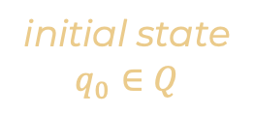
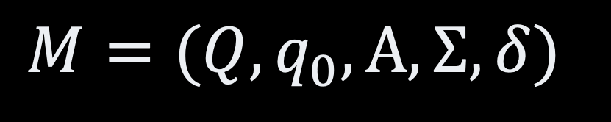
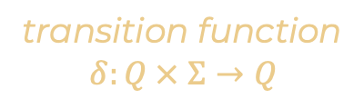

Formal Definition
Finite Automata
initial state
$$q_{0}∈Q$$
set of states
accepting states
$$A⊆Q$$
$$M=(Q, q_{0}, A, Σ, δ)$$
automata
alphabet
(set of symbols)
transition function
$$δ:Q × Σ→Q$$

Slide 12
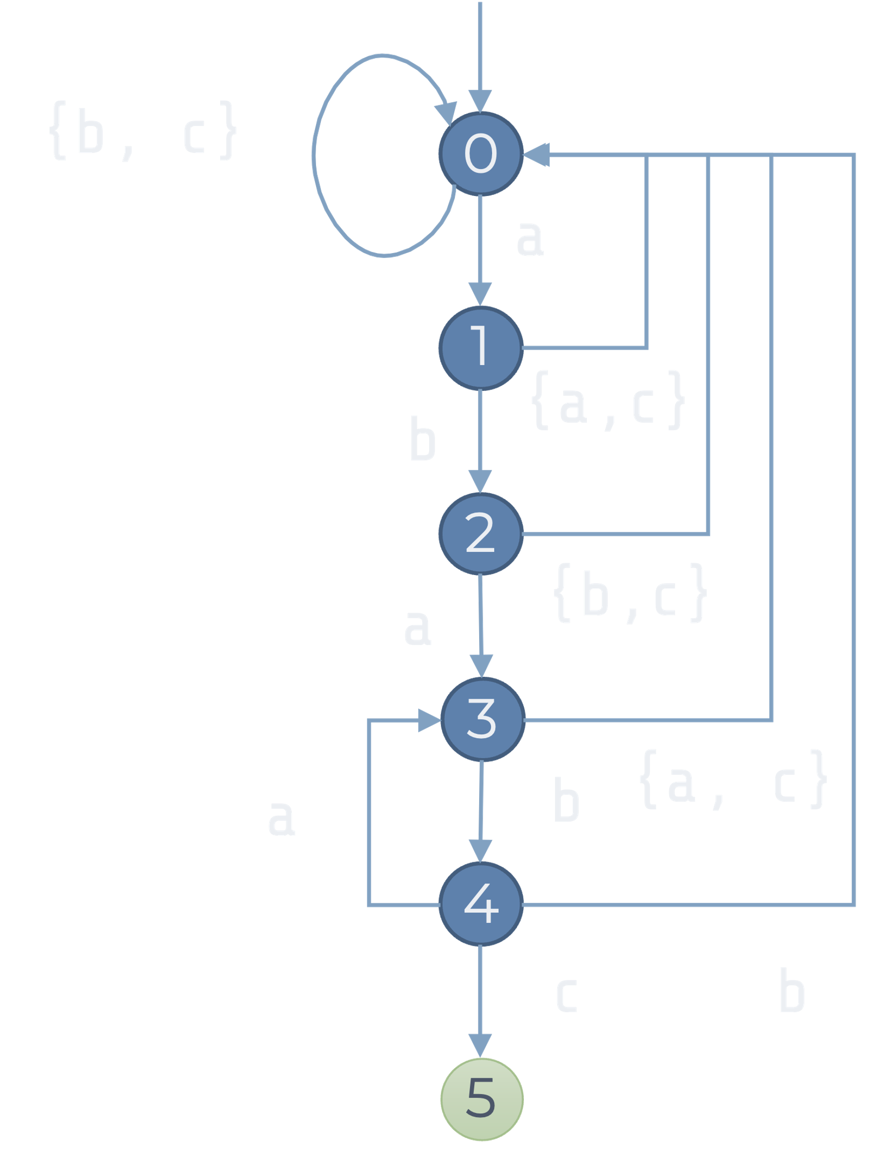

Example
Finite Automata
$Q=\{0, 1, 2, 3, 4, 5\}$
$q_{0}=0$
$A=\{5\}$
$Σ=\{a, b, c\}$
$δ=\left[\begin{matrix}1 & 0 & 0 \\ 0 & 2 & 0 \\ 3 & 0 & 0 \\ 0 & 4 & 0 \\ 3 & 0 & 5 \\ 0 & 0 & 0\end{matrix}\right]$

Slide 13
Matching Using an Automata
{b, c}
0
a
0
1
2
3
4
5
6
7
8
1
b
{a,c}
text
a
b
a
b
a
b
c
b
c
2
a
{b,c}
pattern
a
b
a
b
c
3
0
1
2
3
4
3
4
5
a
b
{a, c}
state:
4
c
b
5

Slide 14
The Code
String Matching With an Automaton
int contains(char[] text, char[] pattern) {
var transitions = createTransitionTable(pattern, alphabet);
int currentState = 0;
for (int index=0 ; index<text.length ; index++) {
currentState = transitions[currentState][text[index]];
if (currentState == pattern.length-1) {
return index;
}
}
return -1;
}

Slide 15

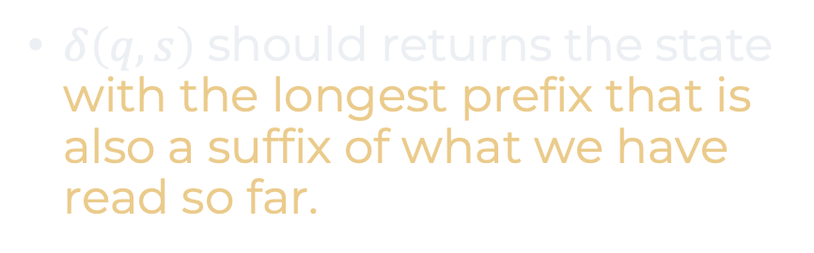
Building the Automaton
$δ\left(q,s\right)$ should returns the state with the longest prefix that is also a suffix of what we have read so far.
0
$$ε$$
a,c
b
a
a,c
b,c
“a”
1
b
a
b
c
2
“ab”
“”
0
1
0
0
a
“a”
1
0
2
0
3
“aba”
“ab”
2
3
0
0
a
b
“aba”
3
0
4
0
4
“abab”
(“abab” + a) ends with “aba”
“abab”
4
3
0
5
c
“ababc”
5
0
0
0
“ababc”
5

Slide 16
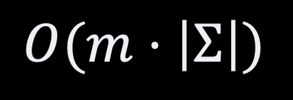
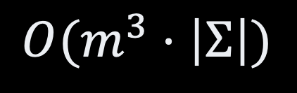
The Code
Building The Automaton
int[][] createAutomaton(char[] pattern, char[] alphabet) {
var transitions = new int[pattern.length+1][alphabet.length];
for (int eachState=0 ; eachState<=pattern.length ; eachState++) {
for (var eachLetter: alphabet) {
var nextState = Math.min(eachState+2, pattern.length+1);
do {
nextState--;
} while (!(pattern.prefix(eachState)+eachLetter)
.endsWith(pattern.prefix(nextState)));
transitions[eachState][eachLetter] = nextState;
}
}
return transitions;
}
$$O(m^{3}⋅\left|Σ\right|)$$
$$O(m⋅\left|Σ\right|)$$

Slide 17
Knuth-Morris-Pratt

Slide 18
Optimizations
KMP vs. Finite Automata
Useless Alphabet
Only distinguish between
match & mismatch
Better Failure handling
More aggressive continuation

Slide 19



Match vs. Mismatch
Optimization n˚ 1
0
$$ε$$
0
fail
a
a,c
b,c
a,c
b
$$ε$$
fail
1
OK
“a”
1
fail
“a”
b
fail
2
“ab”
OK
2
“ab”
a
“aba”
3
OK
“aba”
3
a
b
4
“abab”
OK
4
“abab”
c
“ababc”
5
OK
“ababc”
5

Slide 20
LPS
Optimization n˚ 2
a
b
b
a
c
1
a
a
a
a
c
0
1
2
3
4
5
6
7
2
a
a
a
b
a
c
a
b
a
c
pattern
a
b
a
c
a
b
a
c
a
b
c
a
b
c
0
0
1
0
1
2
3
0
2
a
b
shifts
0
a
b
c
c
a
b
c
c
a
b
c
c
3
a
b
c

Slide 21
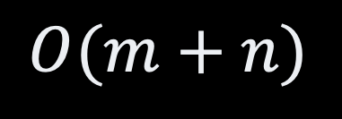
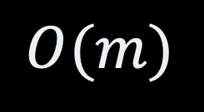
Match vs. Mismatch
Optimization n˚ 2
$$O(m+n)$$
$$O(m)$$
0
$$ε$$
0
a
a,c
b,c
a,c
b
$$ε$$
OK
fail
“a”
1
“a”
1
fail
b
2
“ab”
OK
“ab”
2
a
“aba”
3
OK
“aba”
fail
fail
3
a
b
4
“abab”
OK
4
“abab”
c
“ababc”
5
OK
“ababc”
5

Slide 22
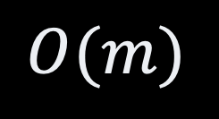
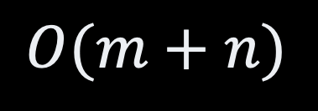
The Code
KMP algorithm
int contains(char[] text, char[] pattern) {
failures = createFailureTable(pattern);
int currentState = 0;
for (int index=0 ; index<text.length ; index++) {
while (currentState > 0 && text[index] != pattern[index]) {
currentState = failures[currentState];
}
if (text[index] == pattern[index]) currentState++;
if (currentState == pattern.length-1) return index;
}
}
$$O(m+n)$$
$$O(m)$$

Slide 23


Building the Prefix Table
0
Recursive by definition
if $w_{1}|x$ is the LPS of $w_{2}|x$
then $w_{1}$ is the LPS of $w_{2}$
$$ε$$
fail
OK
“a”
1
fail
OK
“ab”
2
OK
3
“aba”
fail
fail
OK
4
“abab”
OK
“ababc”
5

Slide 24
The Code
KMP / Building the Failure Table
int[] createFailureTable(char[] text, char[] pattern) {
int[] table = new int[pattern.length];
table[0] = 0;
int longestPrefix = 0;
for (int eachState=1 ; eachState<=pattern.length-1 ; eachState++) {
while (longestPrefix > 0
&& pattern[longestPrefix+1] != pattern[eachState]) {
longestPrefix = table[longestPrefix];
}
if (pattern[longestPrefix+1] != pattern[eachState]) longestPrefix++;
table[eachState] = longestPrefix;
}
return table;
}

Slide 25
Other Algorithms
Boyer-Moore
Similar ideas to KMP
Rabin-Karp
“Fingerprint” matching
use hashing

Slide 26
Recap
Brute force works in practice
  Working in practice
Other solutions
  Hard algorithms
  Finite Automaton
  KMP
Finite Automaton
  Core Computer Science
  Regular Expression
  Compilation
  Computability

Slide 27
Questions, Comments, or Ideas?
Franck Chauvel
Axbit & NTNU
franck.chauvel@ntnu.no

