Slide 1
Getting Started
Welcome & Practicalities
Foundations / Lecture 1
Franck Chauvel
Axbit & NTNU
Ask anything at menti.com with code 6748 8844
franck.chauvel@ntnu.no

Slide 2
Who Am I?
Franck Chauvel
Software Engineer at Axbit AS
franck.chauvel@axbit.com
External resource at NTNU
franck.chauvel@ntnu.no

Slide 3
Agenda
Algorithms and Data Structures?
Why to learn that?
Objectives
Practicalities
Bibliography?

Slide 4
What Is That About?
How to solve
“computational” problems?
Problem
(e.g., add)
data (input)
data (output)
4179
967
5146

Slide 5
Data
Anything encoded with a finite set of symbols
A “word” is a sequence of symbols
Numbers (4179, 0101010, etc.)
Texts (ABC…)
Pictures (RGB, CMYK)
Traffic lights
etc.

Slide 6
Algorithms?
Photo by Ron Lach from Pexels
“Ordered sequence of instructions that solves a computational problem”
Is effective (i.e., correct)
Is finite
Is non-ambiguous

Slide 7
Pre-school Addition
1
1
1
4
1
7
9
+
0
9
6
7
5
1
4
6

Slide 8
Pre-school Addition
Align the two given numbers
Put your finger under the rightmost column.
If there is no digit to read, stop here.
Otherwise, read the digits in this column.
Add these digits to get their sum and the associated carry-over.
Write down this sum into the bottom cell of the current column and the carry over the top cell of the next column.
Move your finger to the next column on the left.
If there is a carry-over, write it down in first cell.
Return to Step 3.
1
1
1
4
1
7
9
+
0
9
6
7
5
1
4
6

Slide 9
Using Flowchart Pre-school Addition
Start
Write down numbers
1
1
1
more to read?
4
1
7
9
Write carry
+
[no]
End
[yes]
0
9
6
7
Move Left
Read numbers
5
1
4
6
Write sum
Add

Slide 10
Using Pseudocode Pre-school Addition
1
1
1
program add:
move_to_right_end
while not_at_left_end:
x, y, carry = read()
s, c = add(x, y, carry)
write_sum(s)
move_left()
write_carry(c)
4
1
7
9
+
0
9
6
7
5
1
4
6

Slide 11
Data Structures?
How do we organize our data.
grids, lists, trees, graphs, etc.

Slide 12
Learning Outcomes
Competence
Solve Computational Problems
Skills
Design algorithms
Argue for Correctness
Knowledge
Big-Oh
Compare Efficiencies
RAM
Arrays, Lists
Trees
Graphs
Hashing
Recursions
etc.

Slide 13
Disclaimer
Solving computational problems is hard
Fluency takes practice

Slide 14
Why to study that?
As software engineers, we build systems that solve problems
Core of “computer Science”
Useful—in my experience.
Entry point of CS theory
Stable body of knowledge
What is asked in job interviews
etc.

Slide 15
Syllabus
Foundations
Sequences
Recursion
Sorting
Hashing
Trees
Graphs
Wrapping-up
Optimization & Regexp

Slide 16
Lectures
3 x 30 min. a week
Lecture Notes for the foundations
1
2
3
4
5
6
7
8
9
10
11
12
13
14
15
Foundations
Foundations
Arrays
Lists
Recursion
Sorting
Hashing
Trees
Trees
Graphs
Optimization
RE
Wrap-up
Rerview
Exam

Slide 17
Lab Sessions
5 lab sessions
Java Programming
2 “qualifying” lab sessions
1
2
3
4
5
6
7
8
9
10
11
12
13
14
15
Foundations
Foundations
Arrays
Lists
Recursion
Sorting
Hashing
Trees
Trees
Graphs
Optimization
RE
Wrap-up
Rerview
Exam
Java
Arrays
Recur.
BST
Mazes

Slide 18
Exam & Grading
1 written final examinations
2 “test” examinations / home
1
2
3
4
5
6
7
8
9
10
11
12
13
14
15
Foundations
Foundations
Arrays
Lists
Recursion
Sorting
Hashing
Trees
Trees
Graphs
Optimization
RE
Wrap-up
Rerview
Exam
Java
Arrays
Recur.
S
BST
Mazes
S
Test 1
Test 2

Slide 19
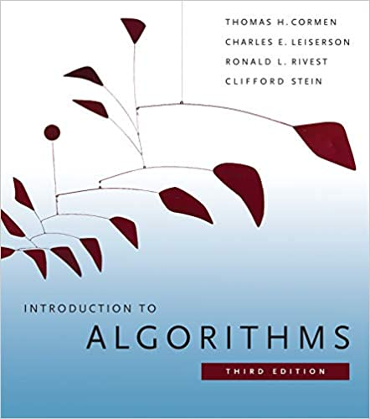
Bibliography
Thomas H. Cormen, Charles E. Leiserson, Ronald L. Rivest, and Clifford Stein. 2009. Introduction to Algorithms, Third Edition (3rd. ed.). The MIT Press.
1312 pages

Slide 20
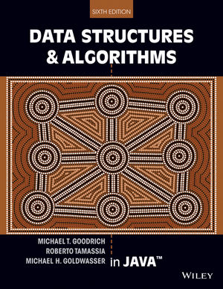
Bibliography
Michael T. Goodrich and Roberto Tamassia. 2003. Data Structures and Algorithms in Java (6th. ed.). John Wiley & Sons, Inc., USA.
656 pages

Slide 21
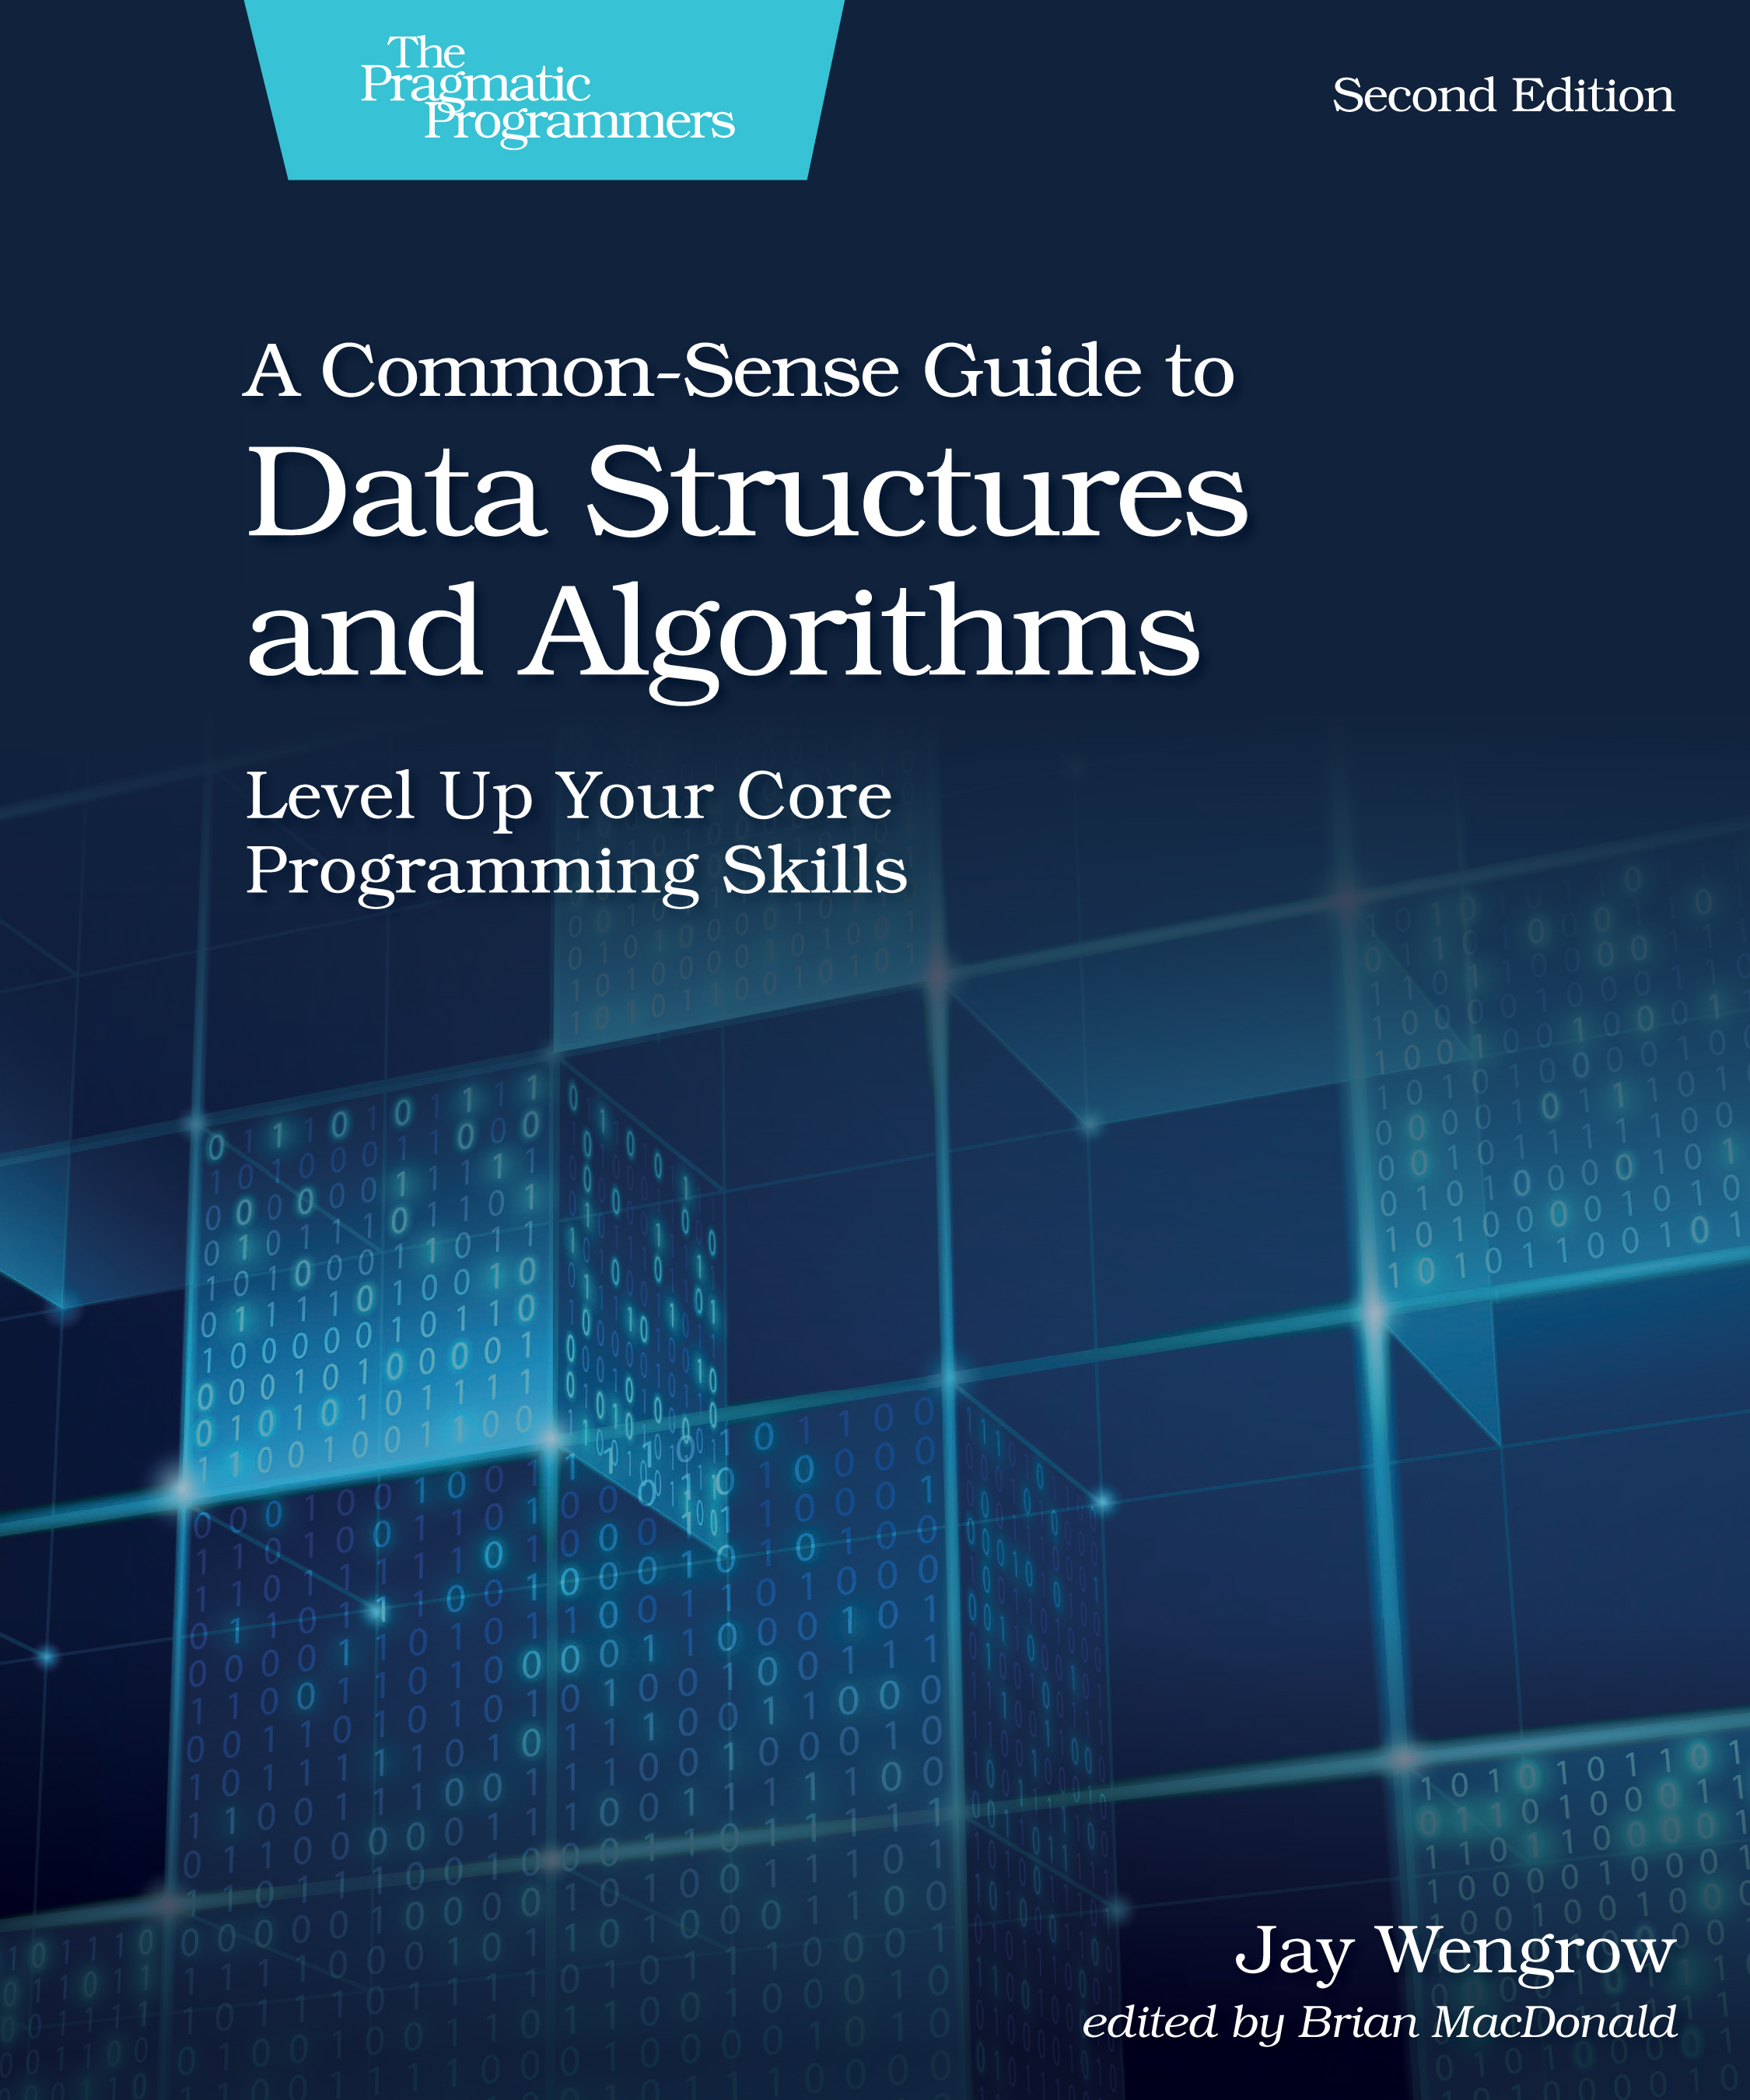
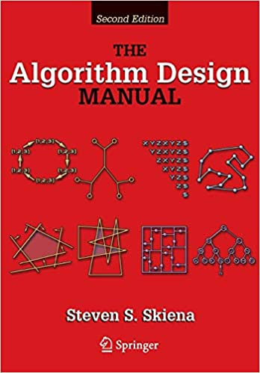
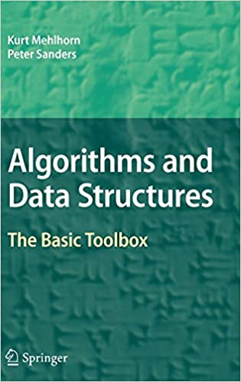
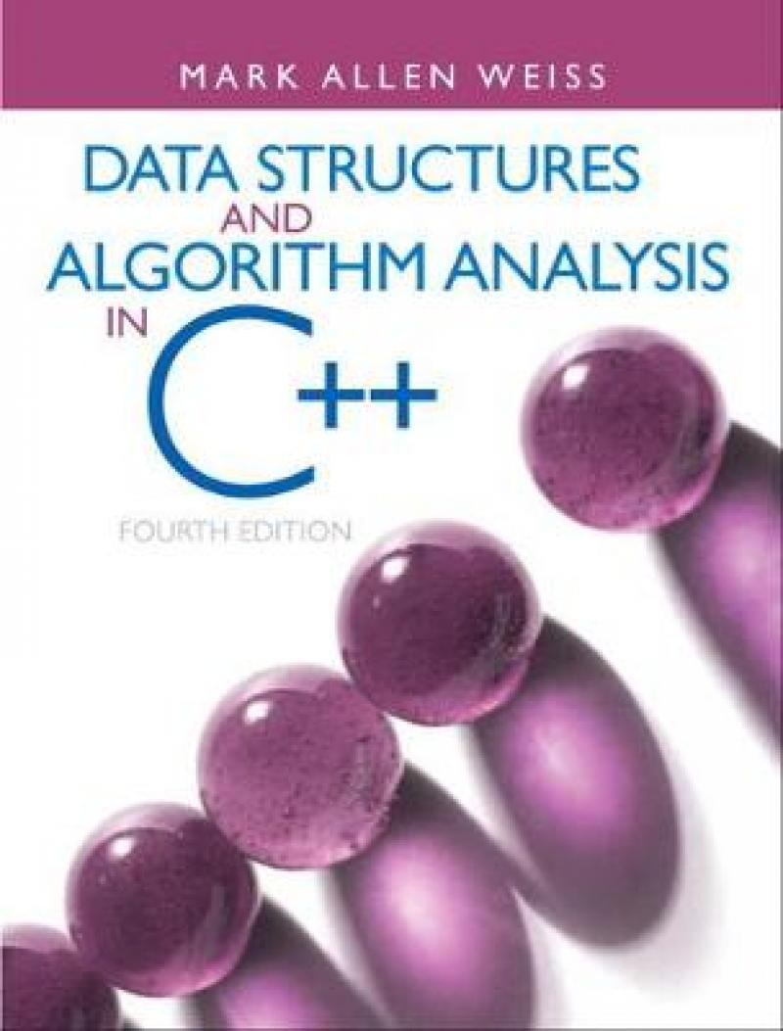
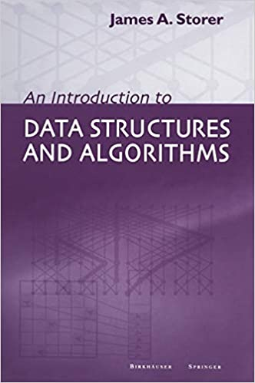
And Many More
Many MOOCs
Coursera
EdX
Udemy
Online Tutorials
Wikipedia
Geeks4Geeks
TutorialsPoints
etc.

Slide 22
Summary
Learn how to solve problems
Using algorithms and data structure
Core of Computer Science
Takes a lot of practice
Don’t wait to get started

Slide 23
Questions, Comments, or Ideas?
Franck Chauvel
Axbit & NTNU
franck.chauvel@gmail.com

Slide 24
Why?
“Computer Science is no more about computers
than astronomy is about telescopes”
attributed to Edsger W. Dijkstra (1930 – 2002)
Safe Investment
Everywhere AI, CV, DB, UI, Compilers, etc,
Useful for job interviews

Slide 25
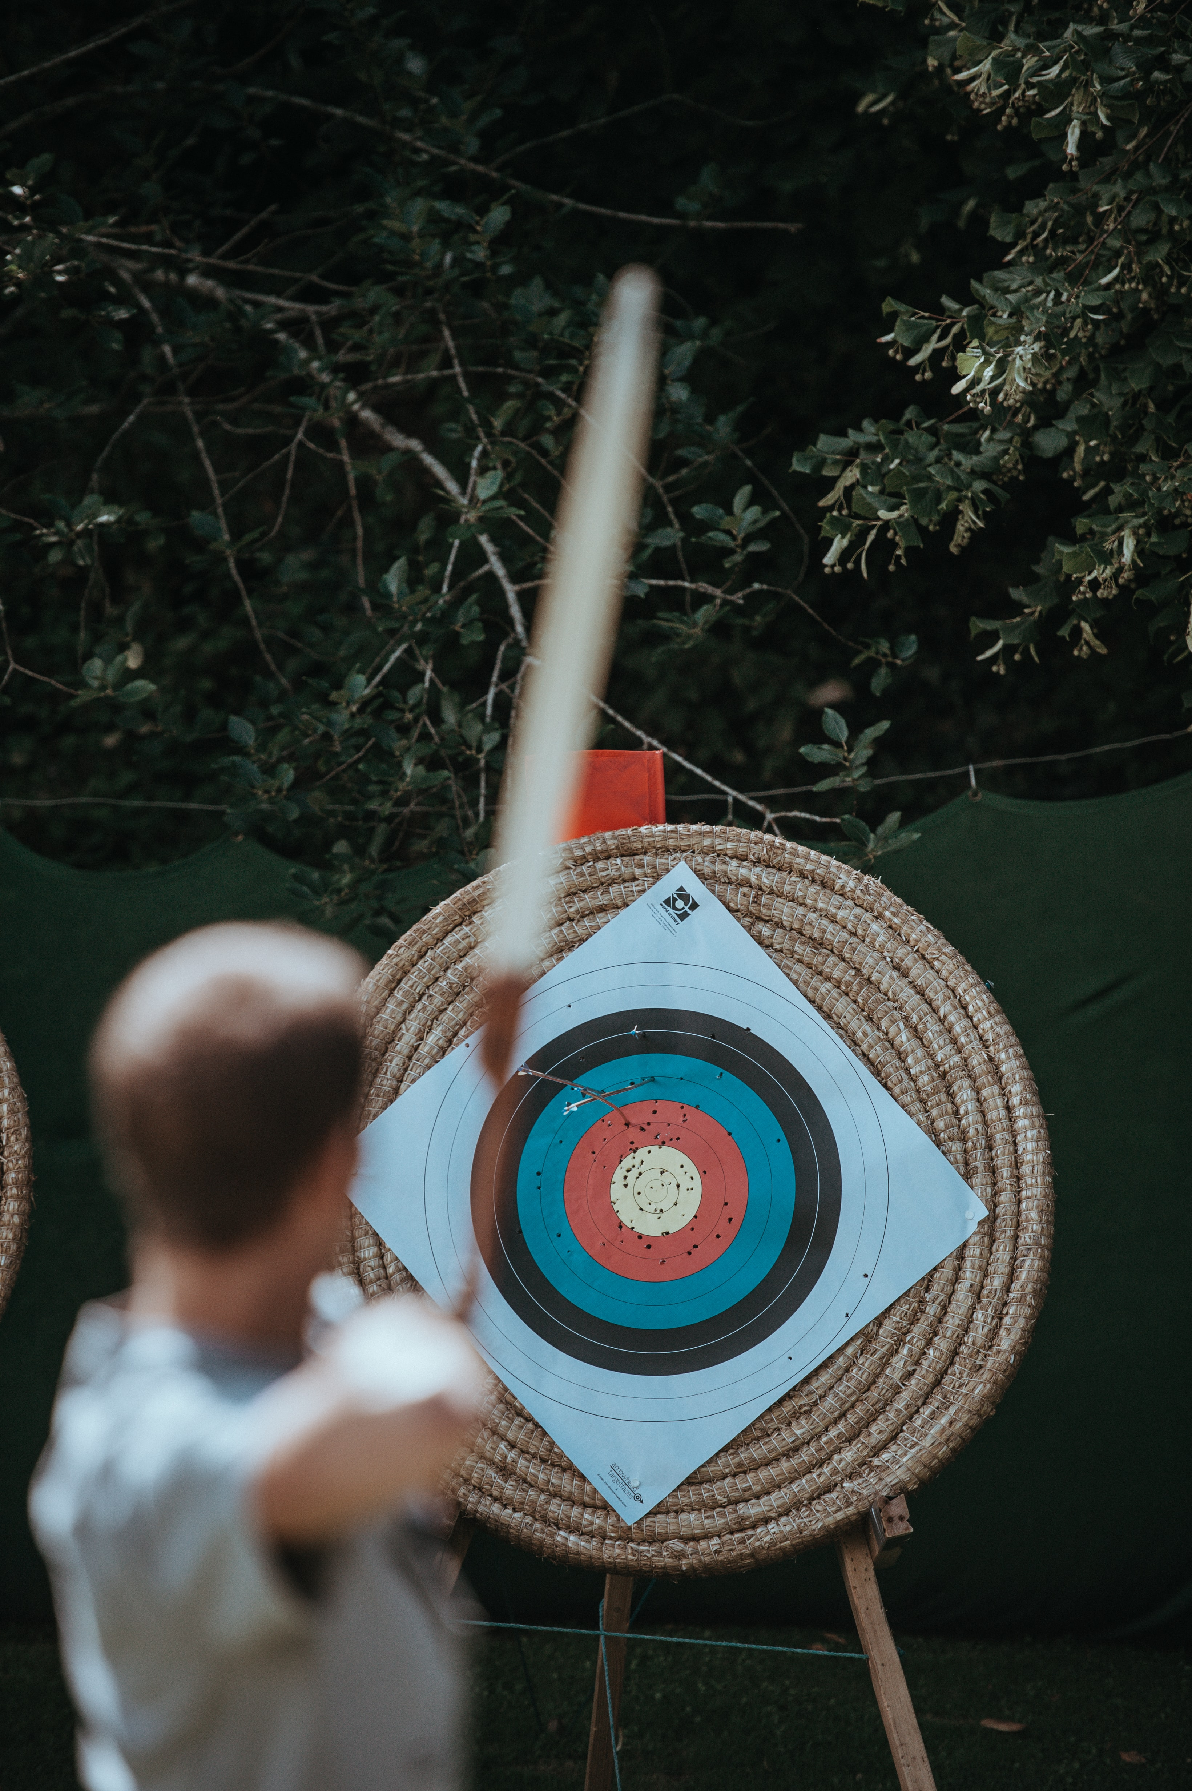
Objectives
Photo by Annie Spratt on Unsplash
Know the common problems
Know the most efficient solutions
Know how to design your own
Know how to evaluate alternatives

Slide 26
Some Maths The 2nd prerequisites
High-school calculus
Probability
Recurences
Series

Slide 27
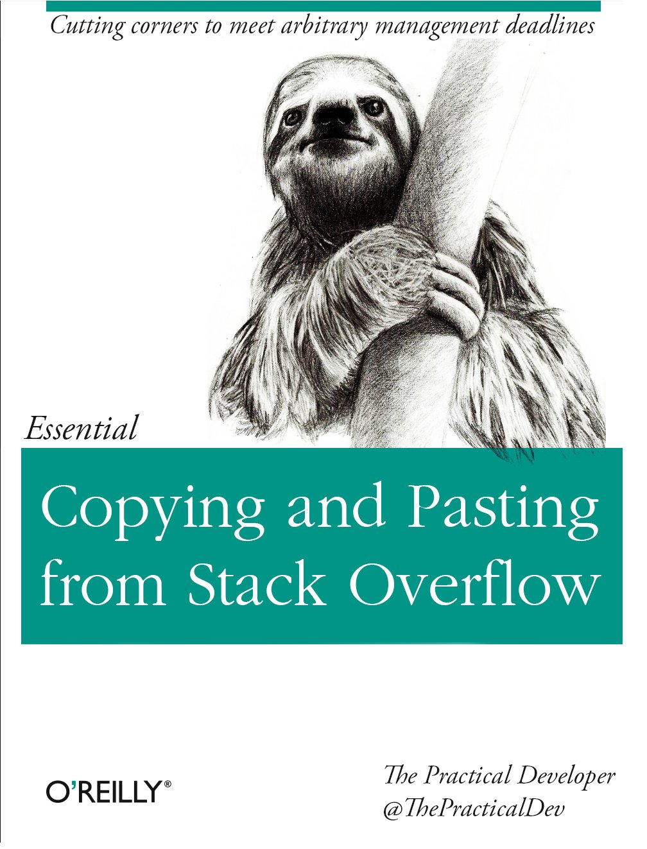
Some Programming The 1st prerequisite
Variables
Conditionals
Loops
Procedures calls

Slide 28
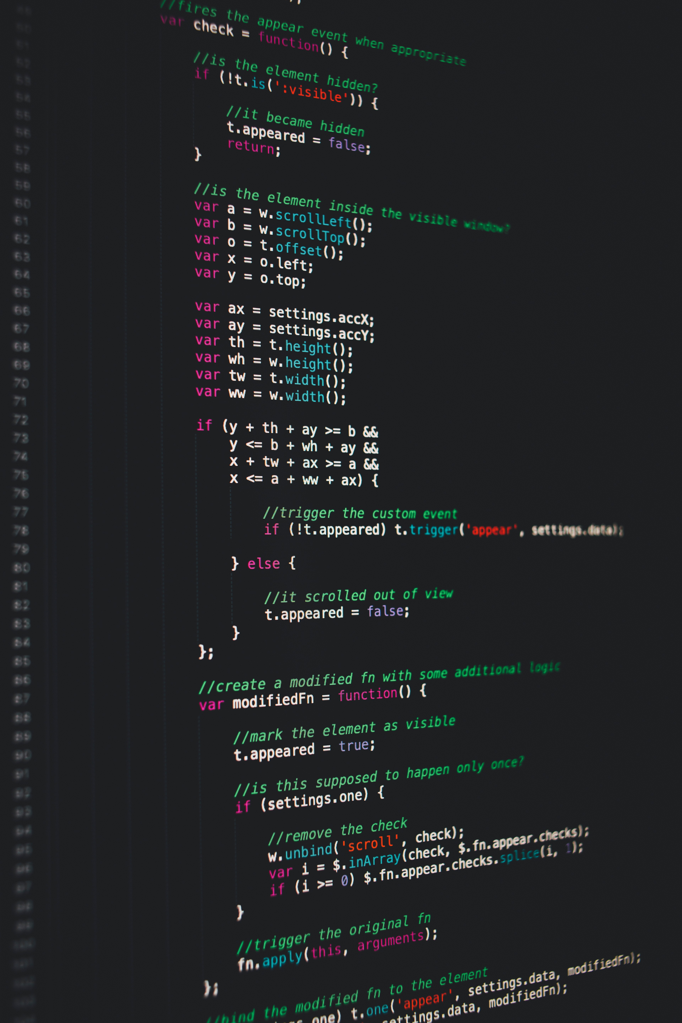
What Programming Language?
Lectures: C, Java, Python, Ruby, Javascript, LISP, etc.
Whatever suits you for the lab sessions.
Photo by Markus Spiske on Unsplash

Slide 29
Bibliography
Knuth, Donald E.. The Art of Computer Programming, Vol. 1: Fundamental Algorithms. Third Reading, Mass.: Addison-Wesley, 1997.

Slide 30
Practicalities
13 weeks + Exam
6 hours a week
2 hours of lectures
4 hours of lab session
(30 min + 1.5 hour) x 3
Weekly Quiz (optional)

